Slide 1
Ring-LWE on 8-bit AVR Embedded Processor
Hwajeong Seo, Hyeokdong Kwon,
Yongbeen Kwon, Kyungho Kim,
Seungju Choi, Hyunjun Kim,
and Kyoungbae Jang

Slide 2
Lattice-based Cryptography
Implementation Platform
Previous Works
Ring-LWE Scheme
Proposed Method

Slide 3

Lattice-based Cryptography
RSA and ECC: Integer Factorization and Elliptic Curve Discrete Logarithm Problem
Hard problems can be solved by Shor’s algorithm
Lattice-based Cryptography: Hard for quantum computers
Ring-LWE Encryption schemes: Proposed [EUROCRYPT’10]
Generic Algorithm for other Lattice-based Cryptography

Slide 4
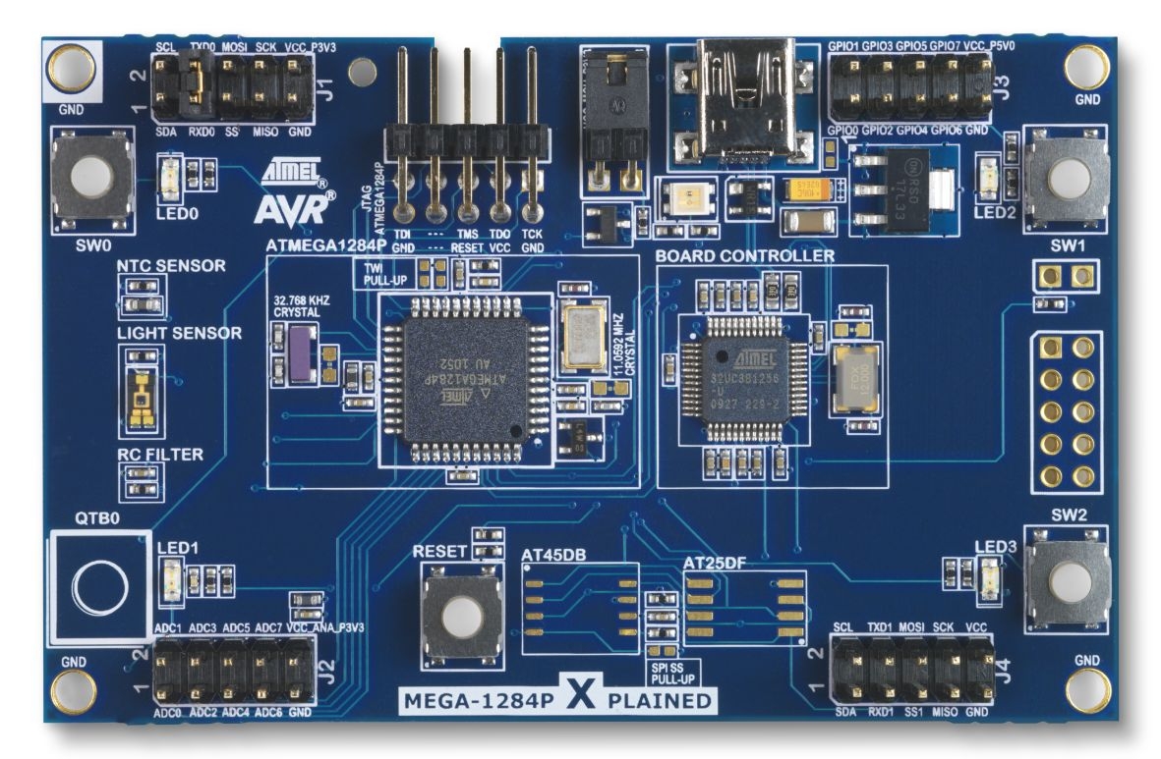
Implementation Platform
8-bit XMEGA128 Microcontroller
Internet of Things
Operating Frequency: 32 MHz
128KB Flash, 8KB RAM, 32 registers
Core Instruction: 8-bit mul/add (2/1 cycles)
AES/DES Crypto Engine (for PRNG)

Slide 5
Previous Implementations on 8-bit AVR processor
8-bit AVR processor: Boorghany et al. [ACM TEC’15]: NTRU, Ring-LWE → Poppelmann et al. [Latincrypt’15]: BLISS → Liu et al. [CHES’15]: Ring-LWE → Liu et al. [ACM TEC’17]: Ring-LWE, BLISS → Seo et al.[ICISC’17]: Ring-LWE → This work [WISA’19]: Ring-LWE

Slide 6

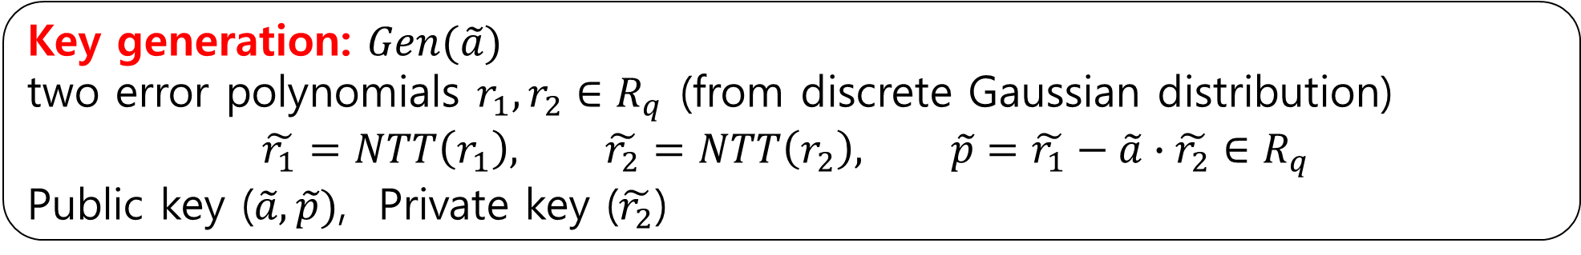

Ring-LWE Scheme
Key generation: $Gen(\tilde{a})$
two error polynomials $r_{1},r_{2}∈R_{q}$ (from discrete Gaussian distribution)
$$\tilde{r_{1}}=NTT\left(r_{1}\right), \tilde{r_{2}}=NTT\left(r_{2}\right), \tilde{p}=\tilde{r_{1}}−\tilde{a}∙\tilde{r_{2}}∈R_{q}$$
Public key ($\tilde{a},\tilde{p})$, Private key ($\tilde{r_{2}}$)
Encryption: $Enc(\tilde{a},\tilde{p},M)$
three error polynomials $e_{1},e_{2},e_{3}∈R_{q}$, message M
$$\left(\tilde{C_{1}},\tilde{C_{2}}\right)=(\tilde{a}∙\tilde{e_{1}}+\tilde{e_{2}}, \tilde{p}∙\tilde{e_{1}}+NTT\left(e_{3}+M\right))$$
Decryption: $Dec(\tilde{C_{1}},\tilde{C_{2}},\tilde{r_{2}})$
Inverse NTT (INTT)
$$M=INTT(\tilde{r_{2}}∙\tilde{C_{1}}+\tilde{C_{2}})$$

Slide 7
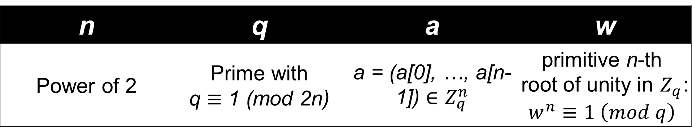

NTT (Number Theoretic Transform): Discrete Fourier transform: n degree polynomial multiplication $O\left(n^{2}\right)→O(nlog{n})$
$$\tilde{a}=NTT\left(a\right), \tilde{a}\left[i\right]= \sum_{j=0}^{n−1}{a[j]w^{ij}} mod q (i=0,1,…,n−1)$$
$$b=INTT\left(\tilde{a}\right), b\left[i\right]=n^{−1}\sum_{j=0}^{n−1}{\tilde{a}[j]w^{−ij}} mod q (i=0,1,…,n−1)$$
$$INTT\left(NTT\left(a\right)\right)=a$$
n | q | a | w
Power of 2 | Prime with q $≡$ 1 (mod 2n) | a = (a[0], …, a[n-1]) $∈Z_{q}^{n}$ | primitive n-th root of unity in $Z_{q}$: $w^{n}≡1 \left(mod q\right)$

Slide 8
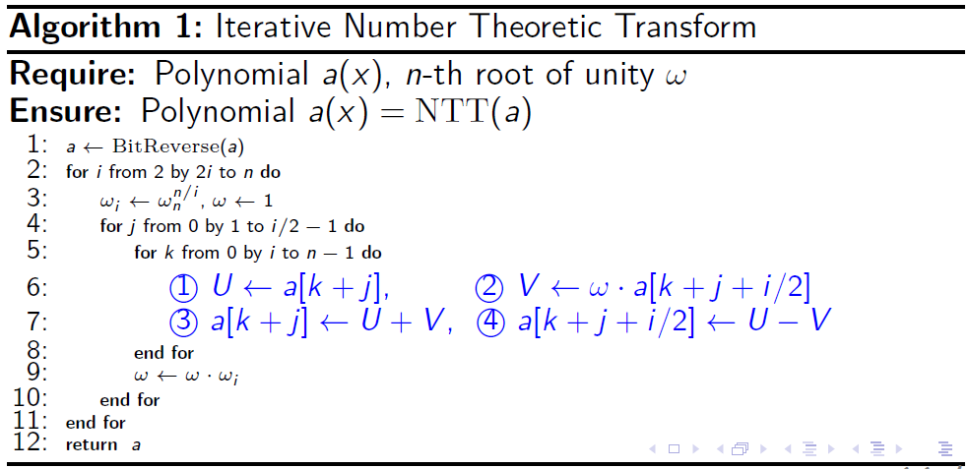
Number Theoretic Transform
Nested loop

Slide 9
Number Theoretic Transform
Overheads: modular multiplication

Slide 10

Previous Modular Reduction
Approximation based reduction [ACM TEC’15]
$\left\lfloor z/q\right\rfloor ≅\sum_{i=1}^{l}{\left(z≫\left(w−p_{i}\right)\right)}$
$z mod q ≅z−q×\left\lfloor z/q\right\rfloor$
$\left\lfloor z/7681\right\rfloor ≅\left(z≫13\right)+\left(z≫17\right)+(z≫21)$

Slide 11
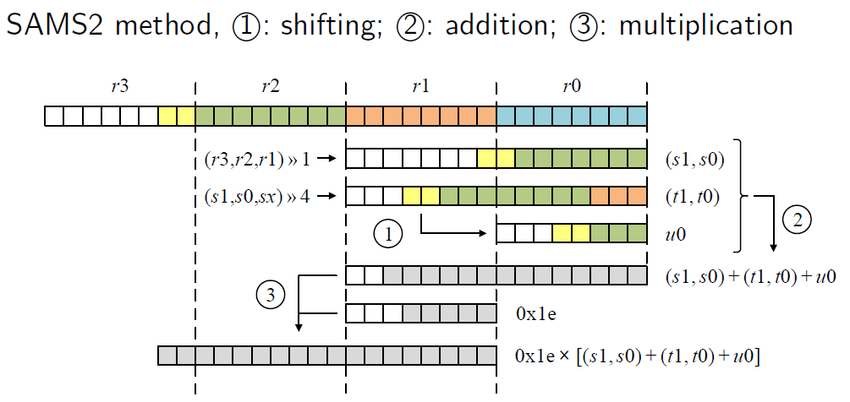
Previous Modular Reduction
Optimized Implementation of approximation based reduction (8-bit) [CHES’15]

Slide 12
Previous Modular Reduction
Optimized Implementation of approximation based reduction (8-bit) [CHES’15]

Slide 13
Previous Modular Reduction
Optimized Implementation of approximation based reduction (8-bit) [CHES’15]

Slide 14

Previous Modular Reduction
Incomplete modular arithmetic [CHES’15]
Complete: $s=a+b mod q$
Incomplete: $s=a+b mod 2^{m}$ where $m=\left\lceil \log_{2}{q}\right\rceil$

Slide 15
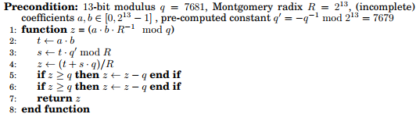
Previous Modular Reduction
Tiny Montgomery reduction [ACM TEC’17]
Main Montgomery multiplication parts

Slide 16
Previous Modular Reduction
Tiny Montgomery reduction [ACM TEC’17]
Final subtraction in masked way

Slide 17
Previous Modular Reduction
LUT based Implementation: (1), (2) LUT access

Slide 18
Previous Modular Reduction
LUT based Implementation: (3) addition

Slide 19
Previous Modular Reduction
LUT based Implementation: (4), (5) shifting

Slide 20
Previous Modular Reduction
LUT based Implementation: (6) modulo

Slide 21
Previous Modular Reduction
LUT based Implementation: (7) addition and subtraction

Slide 22
Motivation & Contribution
Motivation
Few secure 8-bit AVR implementations
High security → basic requirement for IoT
Contributions Secure & efficient Ring-LWE implementation
LUT based multiplication
Constant time modular reduction

Slide 23
Optimization Techniques for Modular Reduction
Previous work: LUT#1 → LUT#2 → addition
Proposed work: LUT#1 → addition → LUT#2
LUT#2 performs reduction on more bits at once than previous work.

Slide 24
Optimization Techniques for Modular Reduction
Proposed method: (1) LUT access

Slide 25
Optimization Techniques for Modular Reduction
Proposed method: (2) addition

Slide 26
Optimization Techniques for Modular Reduction
Proposed method: (3) modulo

Slide 27
Optimization Techniques for Modular Reduction
Proposed method: (4) concatenation

Slide 28
Optimization Techniques for Modular Reduction
Proposed method: (5) LUT access

Slide 29
Optimization Techniques for Modular Reduction
Proposed method: (6) addition

Slide 30
LUT access optimization
Previous work: storing data in 16-bit wise
Proposed work: storing data in 8-bit wise in separated way → memory offset calculation is 1 clock cheaper than previous work

Slide 31
Evaluation
Imp. | 256-bit security
 | Mod MUL | NTT | Const
Boorghany | N/A | 2,207,787 | X
Boorghany | N/A | N/A | X
Poppelmann | N/A | 855,595 | X
Liu | N/A | 441,572 | X
Liu | 70 | 516,971 | O
Seo | 66 | 403,224 | O
This work | 47 | 344,288 | O

Slide 32
Evaluation
Imp. | 256-bit security
 | Mod MUL | NTT | Const
Boorghany | N/A | 2,207,787 | X
Boorghany | N/A | N/A | X
Poppelmann | N/A | 855,595 | X
Liu | N/A | 441,572 | X
Liu | 70 | 516,971 | O
Seo | 66 | 403,224 | O
This work | 47 | 344,288 | O

Slide 33
Evaluation
Imp. | NTT/FFT | Key-Gen | Enc | Secure
Implementations of 256-bit security level
Boorghany | 2,207,787 | N/A | N/A | X
Poppelmann | 855,595 | N/A | 3,279,142 | X
Liu | 441,572 | 2,165,239 | 2,617,459 | X
Liu | 516,971 | N/A | 1,975,806 | O
Seo | 403,224 | N/A | 1,754,064 | O
This work | 344,288 | 1,325,171 | 1,430,601 | O

Slide 34
Conclusion
Contribution
Secure and fast NTT computation
New speed record for Ring-LWE encryption on 8-bit AVR
Future works
Implementations on other low-end processors (8-bit PIC / 16-bit MSP)
Investigation of side channel attack model

